Slide 1
GIT & GITHUB
CONCEPTS AND TOOLS
Anirudh Bhattacharya
Hochschule Hof

Slide 2
CONTENTS
COLLABORATIVE HISTORY TRACKING
OVERVIEW – GIT & GITHUB
SIMPLE WORKFLOW
GIT INSTALLATION
CREATE FREE ACCOUNT ON GITHUB
GET GOING WITH GIT
SYNCHING WITH REMOTE REPO ON GITHUB
CHECKING LOGS
ENABLE GIT AUTOCOMPLETE ON MAC
ENABLE GIT COMMAND COLORS ON MAC
SEND EMAIL NOTIFICATIONS FROM GIT
BRANCHING & MERGING
GIT TAGS
GIT COMMANDS - SUMMARY
Q&A

Slide 3
COLLABORATIVE HISTORY TRACKING
WHO CHANGED IT?
Grammar Fix
Company Logo
WHEN WAS IT CHANGED?
Create Document
Spelling Correction
Color Change
WHY WAS IT CHANGED?
T I M E A N D V E R S I O N S

Slide 4
OVERVIEW - GIT
CREATED BY LINUS TORVALDS IN THE YEAR 2005
INITIALLY DEVELOPED FOR LINUX KERNEL
FREE AND OPEN SOURCE SOFTWARE
UNDER GNU GENERAL PUBLIC LICENSE VERSION 2
DISTRIBUTED VERSION CONTROL SYSTEM, SO CONNECTIVITY DOESN’T BLOCK WORK
EASY, SO LEARNING ITS COMMANDS CAN HAPPEN PROGRESSIVELY
TEAM-CENTRIC, SO COLLABORATION HAPPENS NATURALLY
WEBSITE - https://git-scm.com/

Slide 5
OVERVIEW - GITHUB
ONLINE REPOSITORY MANAGEMENT TOOL
PROVIDES BACKUP
COLLABORATION IS EASIER THROUGH GRANULAR ACCESS
(PRIVATE/PUBLIC SHARING)
SUPPORT OPEN SOURCE CONTRIBUTION
WORLDWIDE: AROUND 100M REPO, 36M DEVELOPERS, 2.1M ORGANIZATONS
GIT IS NOT RELATED TO GITHUB
OTHER ONLINE REPO MANAGEMENT SYSTEMS LIKE BITBUCKET ALSO USE GIT

Slide 6
SIMPLE WORKFLOW
REMOTE
clone/pull
LOCAL
push
commit
add
Index /
Staging Area
Working
copy
REMOTE REPOSITORY
LOCAL SYSTEM

Slide 7

GIT INSTALLATION
DOWNLOAD A GIT INSTALLER
https://git-scm.com/downloads
CHECK GIT VERISON
$ git --version
git version 2.21.0
Image Source: https://git-scm.com/downloads

Slide 8
CREATE FREE ACCOUNT ON GITHUB
GO TO GITHUB WEBSITE
https://github.com
CLICK SIGNUP & FILL YOUR DETAILS (USERNAME, EMAIL ID, PASSWORD)
CLICK CREATE ACCOUNT BUTTON
VERIFY EMAIL FROM GITHUB
ADD GITHUB USERNAME & EMAIL ID TO GIT
$ git config --global user.name “yourGitHubusername”
$ git config --global user.email “yourGitHub@email.com”

Slide 9
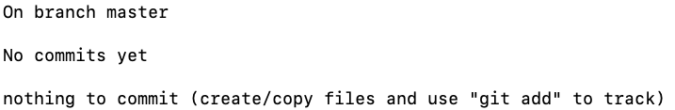
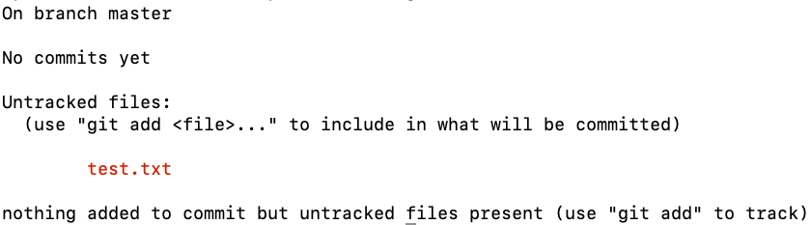
GET GOING WITH GIT
INITIALIZING A GIT PROJECT
$ git init project1 // added a hidden folder “.git”
$ cd project1
$ git status //Checking git status
CREATE FILE test.txt & CHECK STATUS
$ touch test.txt
$ git status //Re-checking git status

Slide 10
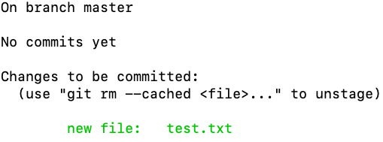

GET GOING WITH GIT
$ git add test.txt //Adding file into git
$ git status //Re-checking git status
$ git commit –m ”added test.txt file” //Committing changes with message
$ git status //Re-checking git status

Slide 11
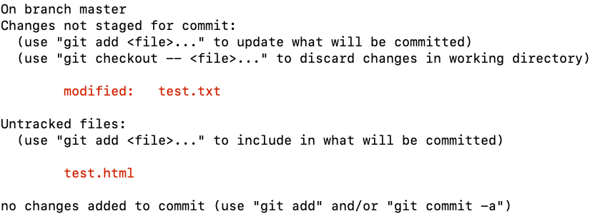
GET GOING WITH GIT
MAKING MULTIPLE CHANGES
$ echo “Hello World” > test.txt
$ touch test.html
$ git status //Re-checking git status

Slide 12
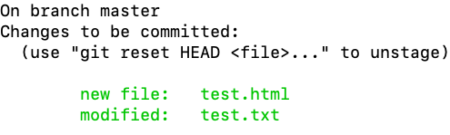

GET GOING WITH GIT
ADDING MULTIPLE CHANGES TO GIT
$ git add . //Adding all the changes to git
$ git status //Re-checking git status
COMMITING ALL CHANGES TO GIT
$ git commit -m "added test.html | modified test.txt file"
$ git status
12

Slide 13
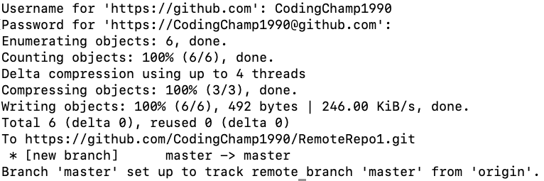
SYNCHING WITH REMOTE REPO ON GITHUB
CREATE NEW REPOSITORY IN GITHUB ACCOUNT
// Username - CodingChamp1990
// RemoteRepo-https://github.com/CodingChamp1990/RemoteRepo1.git
ASSOCIATING THE REMOTE REPOSITORY TO GIT
$ git add remote origin https://github.com/CodingChamp1990/RemoteRepo1.git
$ git push –u origin master //Pushing all the changes to Remote Repo

Slide 14
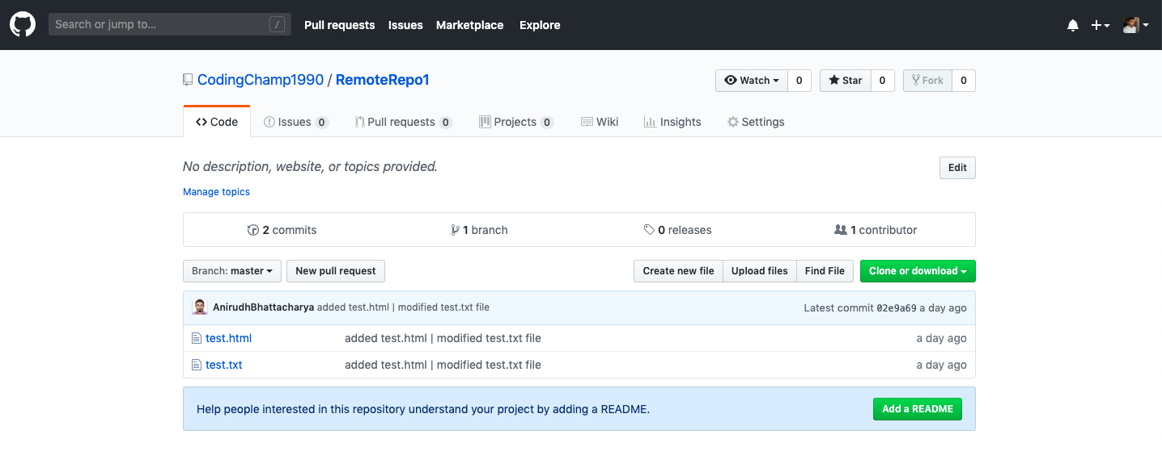
SYNCHING WITH REMOTE REPO ON GITHUB
REMOTE REPO NOW SHOWS ALL CHANGES MADE IN GIT

Slide 15
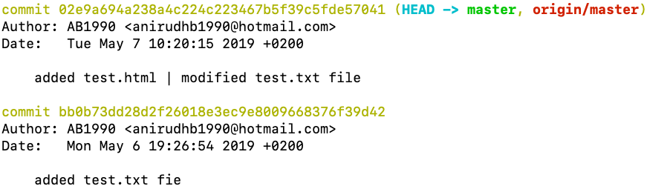
CHECKING LOGS
$ git log

Slide 16
ENABLING GIT AUTOCOMPLETE ON MAC
RUN THE BELOW COMMAND TO DOWNLOAD git-completion.bash FILE
$ curl https://raw.githubusercontent.com/git/git/v2.21.0/contrib/completion/git-completion.bash -o ~/.git-completion.bash
ADD FOLLOWING TO MAKE bash_profile TO SOURCE THE ABOVE FILE
$ vi ~/.bash_profile
if [ -f ~/.git-completion.bash ]; then
source ~/.git-completion.bash
fi
Notes:
Enabling Autocomplete ensures that we can avoid remembering all the git commands and branch names

Slide 17
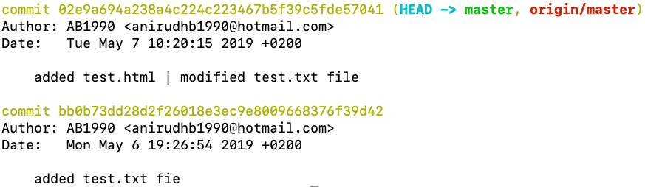
ENABLING GIT COMMAND COLORS ON MAC
$ git config color.ui
$ git config color.ui true
$ git config color.ui
SAMPLE OUTPUT OF ‘$git log’ COMMAND

Slide 18
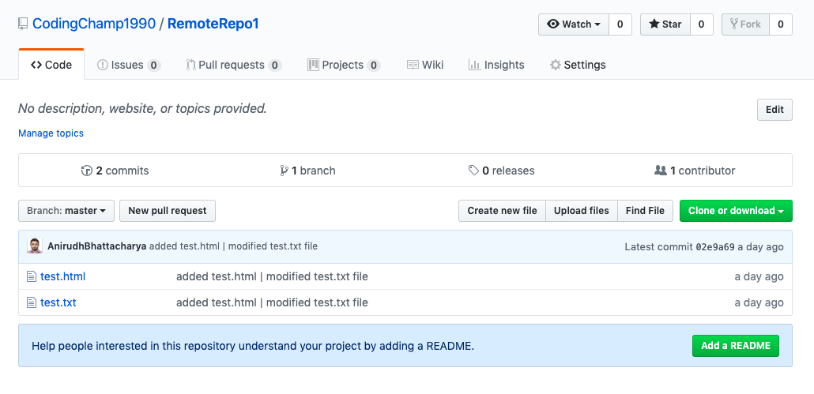
SENDING EMAIL NOTIFICATIONS
GITHUB > REMOTE REPOSITORY > SETTINGS

Slide 19
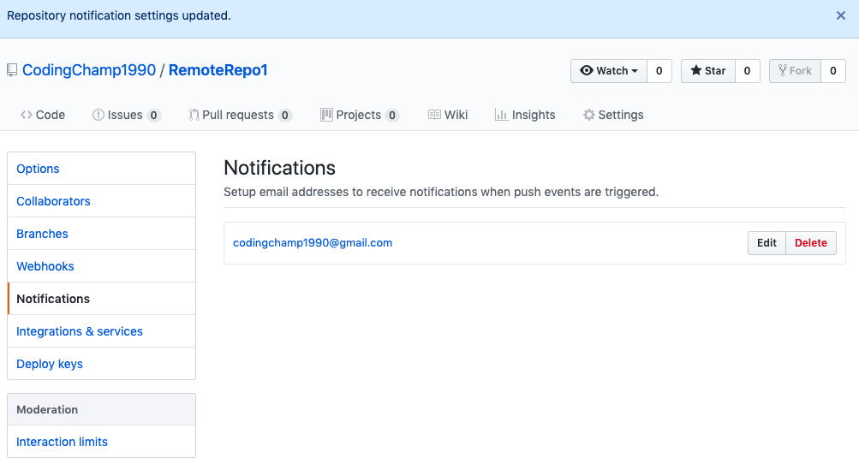
SENDING EMAIL NOTIFICATIONS
SETTINGS > NOTIFICATIONS > ADD EMAIL

Slide 20
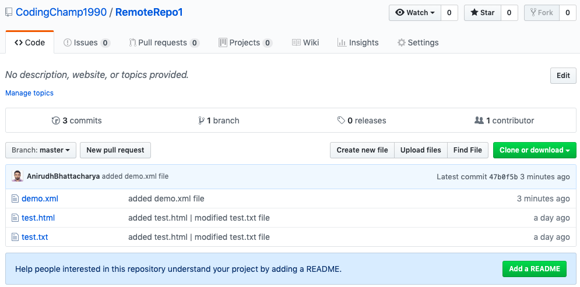
SENDING EMAIL NOTIFICATIONS
TEST AND VALIDATE BY MAKING CHANGES TO REPOSITORY
Notes:
Create a new file -> touch demo.xml
Add the file with git -> git add .
Commit the change with message -> git commit –m “added demo.xml file”
Push the change to remote repo -> git push –u origin master

Slide 21
BRANCHING
CREATE A NEW BRANCH ‘DevStream’
$ git branch DevStream
CHECKOUT ‘DevStream’ BRANCH
$ git checkout DevStream
MAKE CHANGES IN ‘DevStream’ BRANCH
$ touch test2.txt
$ git add .
$ git commit –m “added test2.txt file in DevStream branch”
PUSH THE CHANGES TO REMOTE REPOSITORY
$ git push –u origin DevStream
Notes:
WHAT ARE BRANCHES
HOW TO CREATE A BRANCH
HOW TO CHECKOUT BRANCH
HOW TO MERGE BRANCH TO MASTER
HOW TO DELETE A BRANCH (LOCAL & REMOTE)

Slide 22
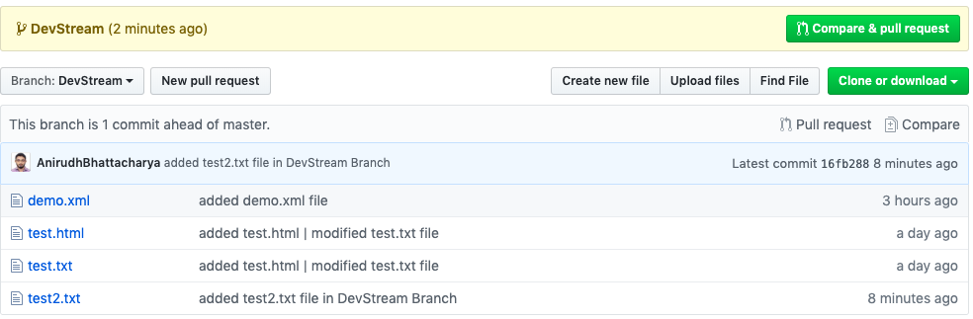
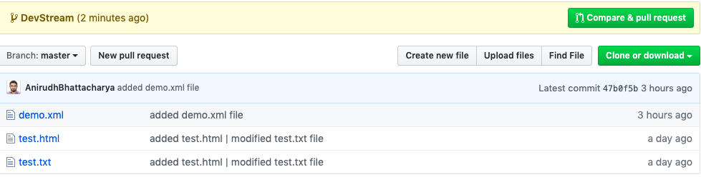
BRANCHING – ADD BRANCH
‘DevStream’ BRANCH IS NOW VISIBLE IN GITHUB
THE CONTENTS OF ‘DevStream’ BRANCH ARE NOT MERGED IN ‘master’ BRANCH
Notes:
WHAT ARE BRANCHES
HOW TO CREATE A BRANCH
HOW TO CHECKOUR BRANCH
HOW TO MERGE BRANCH TO MASTER
HOW TO DELETE A BRANCH (LOCAL & REMOTE)

Slide 23
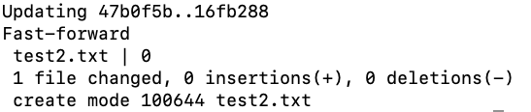

MERGING
CHECKOUT ‘master’ BRANCH
$ git checkout master
MERGE ‘DevStream’ BRANCH CONTENTS TO ‘master’ BRANCH
$ git merge DevStream
PUSH CHANGES TO REMOTE REPOSITORY
$ git push –u origin master
Notes:
WHAT ARE BRANCHES
HOW TO CREATE A BRANCH
HOW TO CHECKOUR BRANCH
HOW TO MERGE BRANCH TO MASTER
HOW TO DELETE A BRANCH (LOCAL & REMOTE)

Slide 24
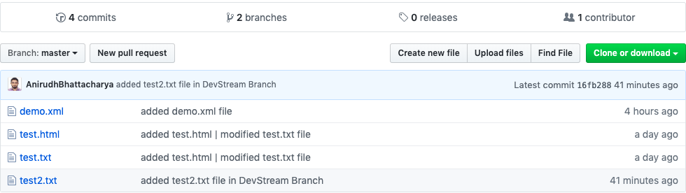
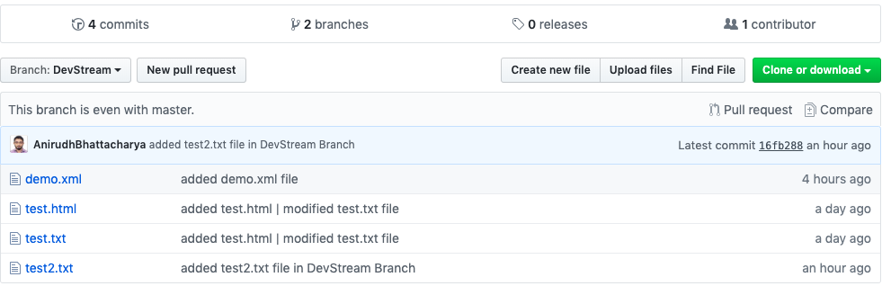
MERGING
‘master’ BRANCH NOW HAS ALL THE CHANGES
‘DevStream’ BRANCH NOW IS EVEN WITH MASTER BRANCH
Notes:
WHAT ARE BRANCHES
HOW TO CREATE A BRANCH
HOW TO CHECKOUR BRANCH
HOW TO MERGE BRANCH TO MASTER
HOW TO DELETE A BRANCH (LOCAL & REMOTE)

Slide 25
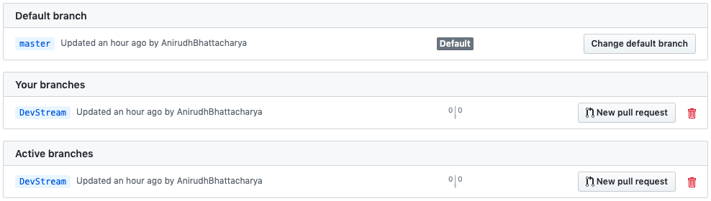
BRANCHING – DELETE BRANCH FROM LOCAL
DELETE A BRANCH ‘DevStream’ FROM LOCAL REPOSITORY
$ git branch –d DevStream
REMOTE REPOSITORY ON GITHUB STILL SHOWS 2 BRANCHES
Notes:
WHAT ARE BRANCHES
HOW TO CREATE A BRANCH
HOW TO CHECKOUT BRANCH
HOW TO MERGE BRANCH TO MASTER
HOW TO DELETE A BRANCH (LOCAL & REMOTE)

Slide 26
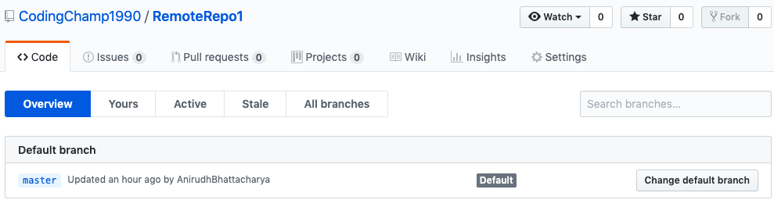
BRANCHING – DELETE BRANCH FROM REMOTE
DELETE A BRANCH ‘DevStream’ FROM REMOTE REPOSITORY
$ git push origin --delete DevStream
REMOTE REPOSITORY ON GITHUB NOW HAS ONLY ‘master’ BRANCH
Notes:
WHAT ARE BRANCHES
HOW TO CREATE A BRANCH
HOW TO CHECKOUT BRANCH
HOW TO MERGE BRANCH TO MASTER
HOW TO DELETE A BRANCH (LOCAL & REMOTE)

Slide 27
GIT TAGS
CHECKOUT BRANCH WHERE YOU WANT TO CREATE TAG
$ git checkout <branchName>
CREATE TAG WITH TAGNAME
$ git tag v1.0
CREATE ANNONATED TAG
$ git tag –a v1.1 –m “version 1.1 of release 1”
NOTE: V1.0 IS LIGHWEIGHTED TAG, V1.1 WILL BE STORED AS A GIT OBJECT CONTAINING ALL INFORMATIONS ABOUT TAGGER ALONG WITH THE TAG MESSAGE
DISPLAY TAG
$ git show v1.1, git tag –l “v1.*”
PUSH TAGS TO REMOTE
$ git push origin v1.0
PUSH ALL TAGS TO REMOTE
$ git push origin —tags / git push –tags
Notes:
CHECKOUT BRANCH WHERE YOU WANT TO CREATE TAG – git checkout <branchName>
CREATE TAG WITH TAGNAME – git tag <tagName>
CREATE ANNONATED TAG – git tag –a v1.1 –m “version 1.0 of release ver 1.1”
// Now v1.0 is a light weighted tag & v1.1 will be stored as a git object and contains all information including message
DISPLAY TAG – git show v1.1, git tag –l “v1.*”
PUSH TAGS TO REMOTE – git push origin v1.0
PUSH ALL TAGS TO REMOTE – git push origin —tags / git push –tags
DELETE TAGS – git tag –d v1.0 / git tag --delete v1.0
DELETE TAGS FROM REMOTE
git push origin –d v1.0 / git push origin --delete v1.0 / git push origin :v1.0
DELETE MULTIPLE TAGS FROM LOCAL – git tag –d v1.0 v1.1
DELETE MULTIPLE TAGS FROM REMOTE – git push origin –d v1.0 v1.1
CHECKOUT BRANCH FROM TAGNAME – git checkout –b <branchName> <tagName>

Slide 28
GIT TAGS
DELETE TAGS
$ git tag –d v1.0
$ git tag --delete v1.0
DELETE TAGS FROM REMOTE
$ git push origin –d v1.0 OR
$ git push origin --delete v1.0 OR
$ git push origin :v1.0
DELETE MULTIPLE TAGS FROM LOCAL
$ git tag –d v1.0 v1.1
DELETE MULTIPLE TAGS FROM REMOTE
$ git push origin –d v1.0 v1.1
CHECKOUT BRANCH FROM TAGNAME
$ git checkout –b <branchName> <tagName>
Notes:
CHECKOUT BRANCH WHERE YOU WANT TO CREATE TAG – git checkout <branchName>
CREATE TAG WITH TAGNAME – git tag <tagName>
CREATE ANNONATED TAG – git tag –a v1.1 –m “version 1.0 of release ver 1.1”
// Now v1.0 is a light weighted tag & v1.1 will be stored as a git object and contains all information including message
DISPLAY TAG – git show v1.1, git tag –l “v1.*”
PUSH TAGS TO REMOTE – git push origin v1.0
PUSH ALL TAGS TO REMOTE – git push origin —tags / git push –tags
DELETE TAGS – git tag –d v1.0 / git tag --delete v1.0
DELETE TAGS FROM REMOTE
git push origin –d v1.0 / git push origin --delete v1.0 / git push origin :v1.0
DELETE MULTIPLE TAGS FROM LOCAL – git tag –d v1.0 v1.1
DELETE MULTIPLE TAGS FROM REMOTE – git push origin –d v1.0 v1.1
CHECKOUT BRANCH FROM TAGNAME – git checkout –b <branchName> <tagName>

Slide 29
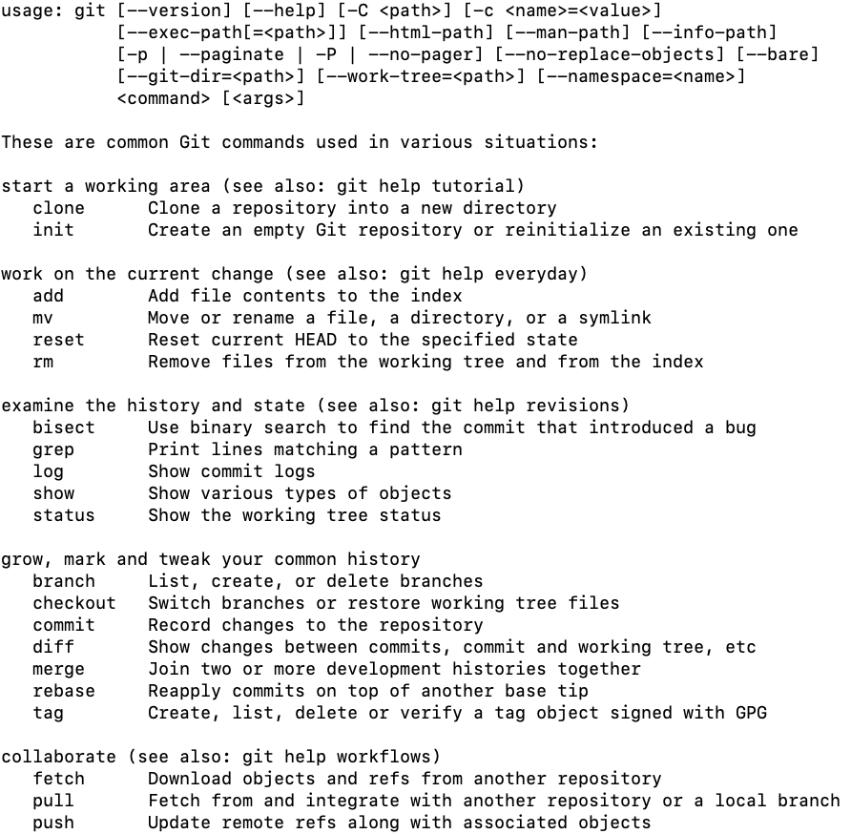
GIT COMMANDS – SUMMARY
$ git --help

Slide 30
Q & A

Slide 31
THANK YOU
31

